Slide 1
Website: Day 5

Slide 2
Contact form section

Slide 3
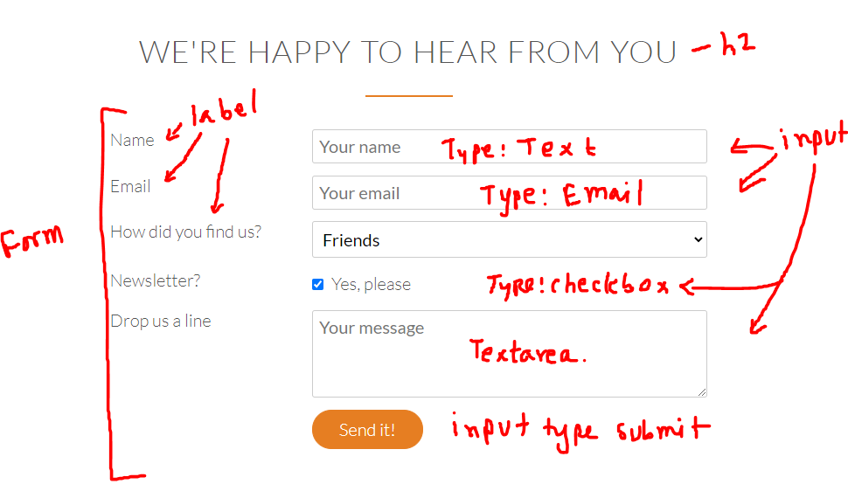
Contact form section

Slide 4
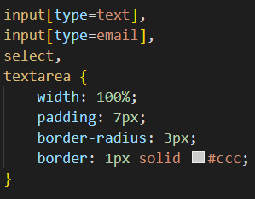
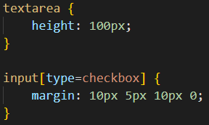
Contact form section
Selecting certain input boxes for styling -

Slide 5


Contact form section
If you are using chrome, it may apply highlighting to an input box when attempting to write in it.
To remove it -
*:focus {outline: none;}

Slide 6
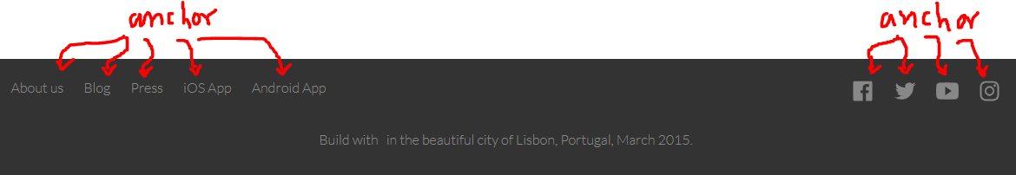
Footer section
Pay special attention to how the anchor tags change when mouse is hovered on them. It should be easy to implement in this stage

Slide 7
Finish designing these sections.
All the best!

